Slide 1
Chain Mail
Position estimation and localization in a large ad-hoc satellite network
Justin Kim
Scrimmage
20
Chain Mail
Chain Mail is for rapidly determining satellite positions in a large proliferated constellation, addressing a major challenge for future operators.
A localization algorithm will use network crosslink and routing information to estimate absolute position, without large computational overhead or a centralized computing system.
Current LEO satellites rely on some combination of sensors, GPS, and ground tracking to determine their positions. In a large, proliferated, ad-hoc networked constellation, these methods may be too time/cost/effort expensive. We will investigate the benefits of wireless localization algorithms for rapid and efficient position estimation.
In the first sprint, we will determine and demonstrate the appropriate algorithms to perform localization in an ad-hoc 2D network. This will include algorithm selection (distributed vs centralized, range-based vs range-free), implementation, and preliminary evaluation of results. The next sprint will extend the results to a 3D network.

Slide 2
Chain Mail
Position estimation and localization in a large ad-hoc satellite network
Justin Kim
Wireless ad-hoc localization is an area of active research. We can leverage the algorithms and methods developed for terrestrial localization and apply them to satellite networks. However, ad-hoc localization in large proliferated satellite networks has not been thoroughly investigated, and there is a wealth of unique research to be done e.g.:
Centralized vs distributed localization
Range-based vs range-free algorithms
Lateration vs angulation
Symmetric vs asymmetric links
Reference node optimization: ratio, density, placement, self-configuration
Absolute vs relative localization (and fusion)
Provisioning and routing algorithms from Project Packet will be used to set the network topology. The network topology will inform the selection of appropriate algorithms, which will be tested and evaluated first in a 2D network, and later expanded to a 3D network.

Slide 3
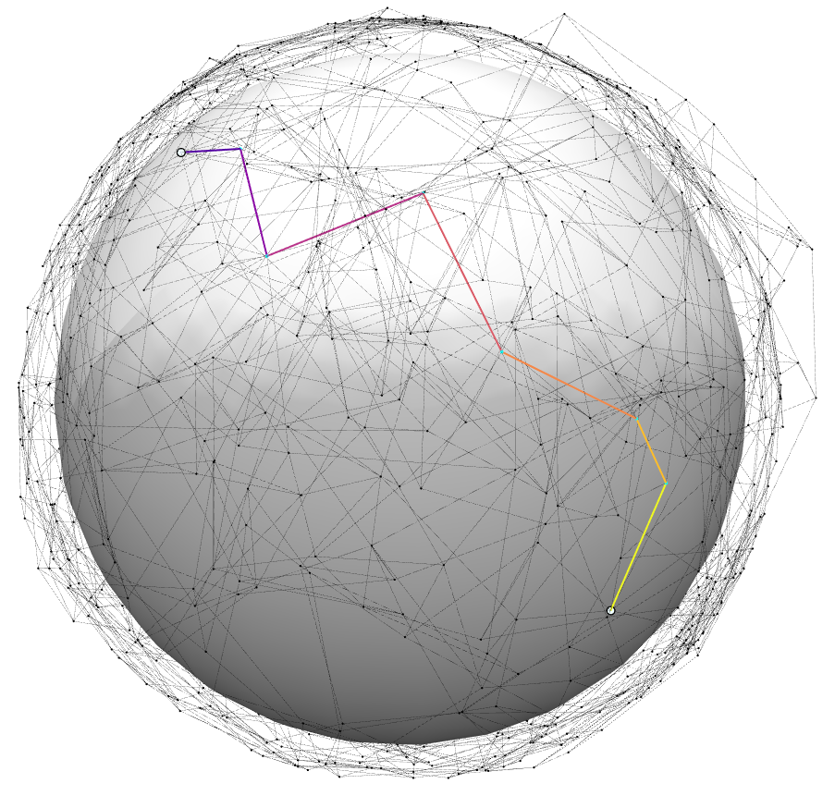
Chain Mail
Position estimation and localization in a large ad-hoc satellite network
Justin Kim
With Chain Mail we will implement a localization algorithm that uses crosslink connectivity and routing paths to estimate satellite position.
Provisioning and routing results from Project Packet (shown right) will provide the network topology and routing paths for the algorithms.

Slide 4
Chain Mail
Position estimation and localization in a large ad-hoc satellite network
Justin Kim

Slide 5
Chain Mail
The large number of satellites in future proliferated LEO constellations will pose a challenge to SSA operators. We need efficient methods for cooperatively determining the position of the satellites.
Can we use network messages between satellites to determine satellite position.
If you have the provisioning crosslinks, can an algorithm reconstruct the layout of the network?
Want DISTRIBUTED (vs centralized) and ABSOLUTE (vs relative) localization algorithm
In a multihop sensor network with a set of beacon nodes, localization problem is to find the position of as many dumb nodes as possible

Slide 6
Plan
Plan:
Create test scenarios (2d, then 3d)
Choose appropriate LA based on assumptions (a priori distance knowledge, range-based vs range-free, distributed vs centralized, absolute vs local, symmetric vs asymmetric)
Implement LA
Evaluate (position error, unfound nodes, compute time)
Research questions:
How many anchor nodes are necessary? How should they be deployed? (ratio, density, random placement?)
Can we assume pair-wise distances are known? Or must they be estimated?
Unique research: hasn’t been done in 3d for non-uniform ad-hoc dense network

Slide 7
Wireless_LA
Localization: location/position estimation
Dumb node: doesn’t know its position aka free / unknown nodes
Settled node: a node which was initially dumb, but knows its position due to localization algorithm
Anchor/ref node: node that knows its position from the start, and always knows its position without use of the localization algorithm
Node links may be symmetric or asymmetric
Lateration: when distance is used as primary means to determine node location
Angulation: angle
Range-based
In a plane, need distance measurements from at least 3 beacon nodes to trilaterate and estimate position
In 3d space, need at least 4 beacons (multilateration)
Range-free (proximity-based, connectivity-based)
LAs can be centralized or distributed
Section 2.2: goals of LA

Slide 8
Wireless_LA
5.2 Convex Position Estimation
5.2 Convex Position Estimation
Must know positions of anchor nodes
Connectivity information is known, modeled as a set of geometric constraints
Centralized algorithm – all nodes must send connectivity information to central processor
Ad Hoc Positioning System
Range-free, distributed processing
Uses multilateration (needs 3+ anchor nodes)
5.4 MDS-MAP
Centralized algorithm
Works well in uniformly distributed networks where shortest (djikstra) path corresponds to Euclidean distance
Not great for anisoptropic and irregular networks
MDS-MAP(P) – good for both uniform and irregular networks
Local maps (patches) merged
Partially distributed processing approach. Central processor required to construct the global map

Slide 9
Distributed_LA_survey
Distributed localization algorithms determine relative positions
For absolute positions, need anchor nodes
Localization algorithms can be range-based or range-free
Absolute or relative
Based on distances, all nodes can estimate relative positions through distributed localization algorithms
In the presence of anchor nodes, absolute positions can be derived
Fraction of anchor nodes and their positions are critical to precision and performance
Self-configuring is to select the optimal node to be an anchor for efficient and robust localization
Range-based assumes all nodes can measure relative distance or angle between connected nodes
Mainly focus on static networks with anchor nodes having a priori knowledge of their positions
MDS only estimates positions along a propagation path, with src and dst as anchors

